Slide 1
Netplan -
Setup

Slide 2
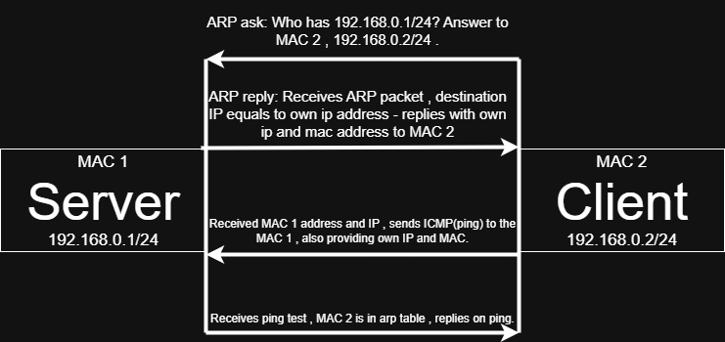
Connection scheme &
How communication happens

Slide 3
Usual problems:
1) Wrong Network adapter configuration
2) Mistype in netplan configuration
3) Usage of not reserved for local use IP address (ex. Using public IP and mask for netplan configuration)

